Slide 1


Taming conflicting I/O applications by means of malleability
Adaptive scheduling of HPC applications using malleability and dynamic migration.
Alberto Cascajo, David E. Singh and Jesús Carretero
University Carlos III of Madrid (Spain)
14th Scheduling for Large Scale Workshop

Slide 2
List of contents
Introduction
System architecture
  Overview
  DaeMon Monitor
  Application Control
Evaluation
Conclusions & future works
14th Scheduling for Large Scale Workshop
2
Notes:
This is the list of contents:
a little introduction
the description of the architecture with its two modules
A little evaluation
and the conclusions and feature works.

Slide 3
List of contents
Introduction
System architecture
  Overview
  DaeMon Monitor
  Application Control
Evaluation
Conclusions & future works
14th Scheduling for Large Scale Workshop
3

Slide 4


Flex-MPI
Introduction
Challenges in cluster computing
  Cooperative components: monitor, scheduler and applications
  Efficient use of the hardware resources (job scheduling).
  Desirable requirements: scalable, fault tolerance, energy-aware
  Focused on contention avoidance
14th Scheduling for Large Scale Workshop
4
Notes:
The introduction tries to show the challenges that we have to face in the field of cluster computing, LSDS and the preparation for Exascale.
Design tools that can cooperate to reach better their goals
Efficient Use of the hardware resources thanks to job scheduling
Provide some desirable requirements
And put the focus on contention avoidance.

Slide 5
Flex-MPI
Introduction
Goals
  Light-weight and scalable monitoring tool for LSDS and production clusters
  Combine node and application monitorization
  Combine scheduling and application malleability
  Fault tolerance (Resilience)
14th Scheduling for Large Scale Workshop
5
Notes:
Knowing this challenges, our goals are develop a:
in order to get the best relation between performance and the used resources
for application migration, that provides the resource use optimization
With TMR and watchdog processes trying not to lose information if there is a failure.

Slide 6
List of contents
Introduction
System architecture
  Overview
  DaeMon Monitor
  Application Control
Evaluation
Conclusions & future works
14th Scheduling for Large Scale Workshop
6
Notes:
Now I’m going to describe the architecture, trying to show you the benefits of combine node with application monitoring.

Slide 7
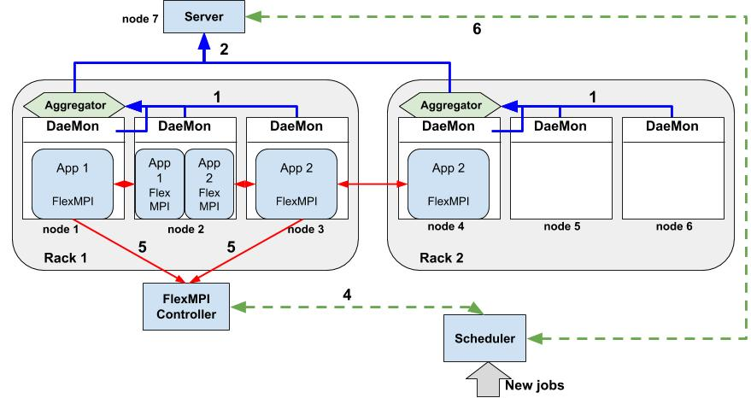
Flex-MPI
Overview system architecture
14th Scheduling for Large Scale Workshop
7
Notes:
This is a global overview in which you can see different components, for example
-at a hardware level, 2 racks with 3 nodes each one.
-And in a sorftware level you can try to distinguish 2 regions: from the mid to the top, which is the node monitoring module, and from the mid to the bottom the scheduler and FlexMPI module.

Slide 8
Flex-MPI
Dynamic Overview
14th Scheduling for Large Scale Workshop
8
Notes:
Now I want to show you dynamically how the system will work in a simple case of study:
In a moment, one user wants to execute its application, the sched. ask for nodes to the server and the scheduler allocate the apps in that nodes. In this moment there is any problem because the application is running lonely.
But, maybe the same user (or maybe other) wants to execute other application… In that case, the process is the same and the sched. will allocate the app in the listed nodes.
Here we could have 2 cases:
- One in wihich the two apps al running with their expected performance, so there is no necessity of do anything
- Or the second, in which one or the two applications have poorer performance than the expected. In this case, the server will detect that situation based on the used resources, and proceed to notify the scheduler about it.
With this information, the scheduler check the application behaviours to confirm that results, and move one of the applications to an other free node (in order ti avoid the contention).

Slide 9
List of contents
Introduction
System architecture
  Overview
  DaeMon Monitor
  Application Control
Evaluation
Conclusions & future works
14th Scheduling for Large Scale Workshop
9
Notes:
After this explanation, I want to present you the main details of this architecture
At first, the Daemon monitor, and then the application control.

Slide 10
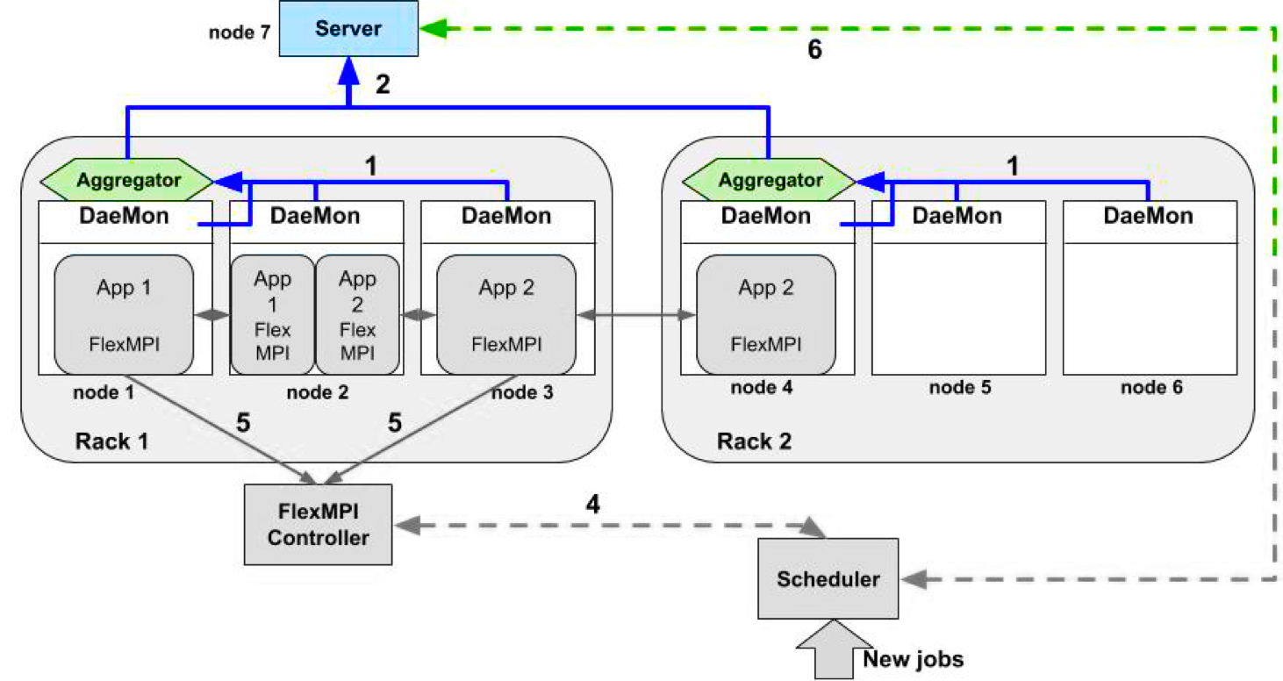
Flex-MPI
Monitoring System
14th Scheduling for Large Scale Workshop
10
Notes:
So, now, I’m going to focus the attention in the monitoring system

Slide 11
Flex-MPI
Monitor architecture (I)
Medium scale deployment example
  Scalability evaluation in real cluster and Omnet++
  Up to 200 nodes
14th Scheduling for Large Scale Workshop
11
Notes:
This is an example of a medium-scale deployment, and this deployment is available if your cluster has up to 200 nodes.
We define some stress tests and this is the worst result that we’ve obtained. This is the result of establish the worst processing time per received package in the server.

Slide 12
Flex-MPI
Monitor architecture (II)
Large scale deployment example
14th Scheduling for Large Scale Workshop
12
Notes:
And here you can see an example of a large-scale deployment, that includes some new objects (named Aggregators (painted in green)) to provide the scalability.
Here we can see the 3 components:
-DaeMon monoitor nodes: they are the circles painted in blue.
-Aggregators: the circles painted in green
-And the servers: which share a DB.
So, as you can imagine, all daemon monitors will send their measuremens to their upper nodes (in this case all are aggregators), then, each aggregator send its information to the server. And finally, the server process the information and store the main values in a in-memory database,

Slide 13
Flex-MPI
DaeMon monitor
  Three main roles: server, Agg. node and DM node.
  DM reads stats from each node and each ‘x’ time
    Configuration (total resources)
    Current CPU usage, main memory, IO, net, GPU, etc.
  Each node sends its information to the server through UDP sockets
  Server processes the information received and manage an in-memory DB.
14th Scheduling for Large Scale Workshop
13
Notes:
-This is a global explanation of the monitoring tool, similar than my comments in the last slide.
-The interval time is defined by the user
-Configuration is read only at the beginning (usually the architecture doesn’t change while the system is still running.
-Info is sent directly or through intermediate nodes

Slide 14
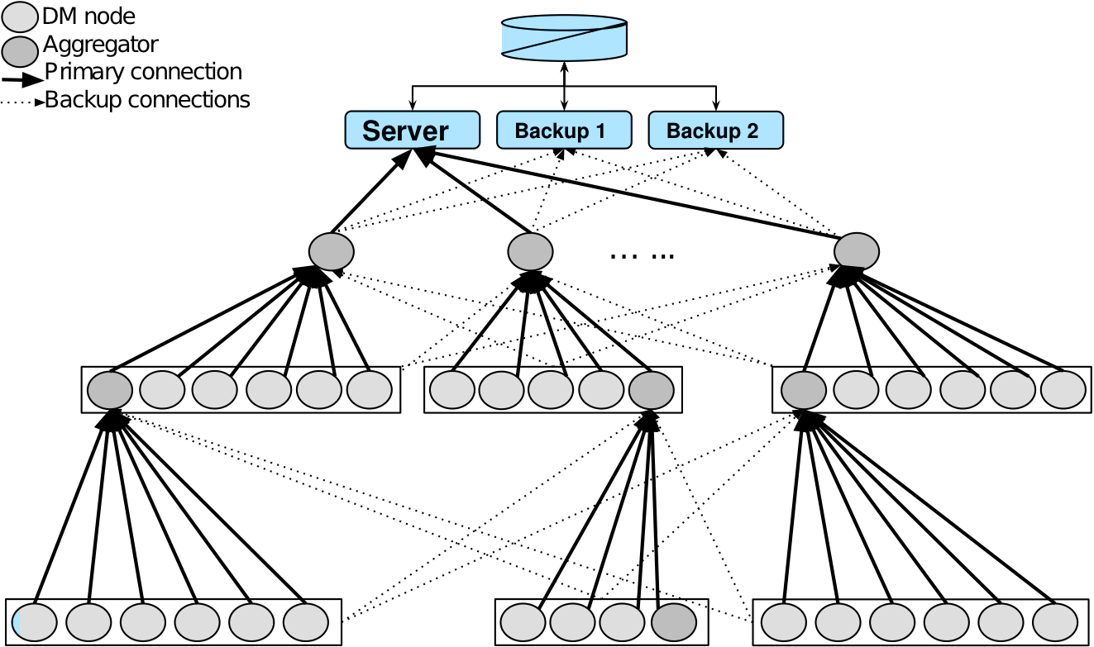
Flex-MPI
Focus on server
14th Scheduling for Large Scale Workshop
14
Notes:
In this point I’m going to explain the Server features.

Slide 15
Flex-MPI
Server
  It start as a watchdog process
  Th1: Receiver
  Th2: Dispatcher
  Th3: Client manager
  Pool of threads: Processors
    Extracts main information
    Stores it into in-memory database
    Send notifications if hot-spot is detected
14th Scheduling for Large Scale Workshop
15
Notes:
It is a multi-threaded application that provides a high capability of packet computation
Receives the information from the whole nodes and stores each packet in a buffer
→ Gets each packet and gives it to a free thread
→ Provides information to the client when he asks for sth (e.g. current system state)
→ Receives a packet and manage it

Slide 16
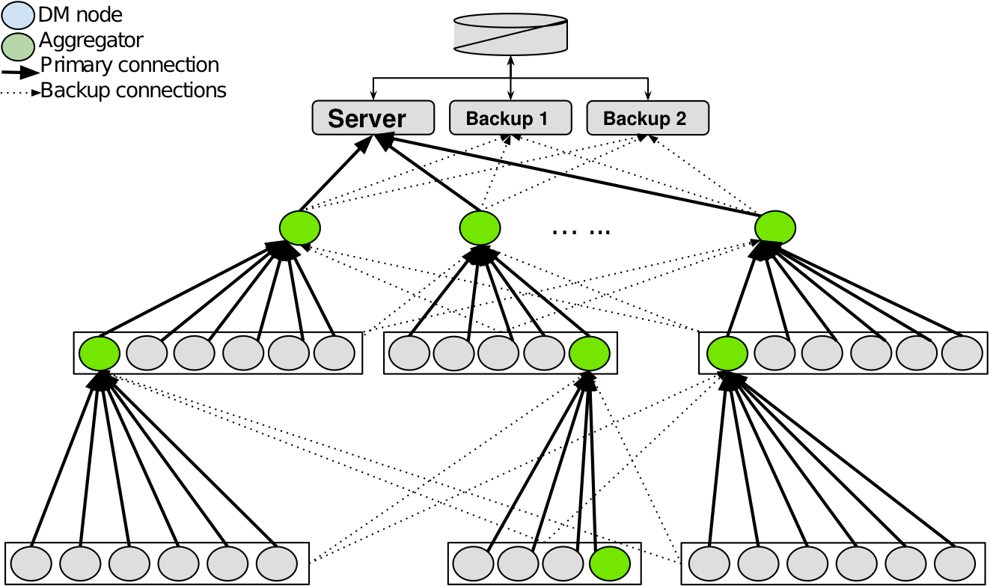
Flex-MPI
Focus on Aggregators
14th Scheduling for Large Scale Workshop
16
Notes:
Ocular y destacar los azules
Finally, I’m going to describe the aggregator functionality

Slide 17
Flex-MPI
Aggregator node
Aggregator nodes:
  Node which gets samples from ‘n’ machines
  Starts as a watchdog process
  Allows the user to design a hierarchical (or many other) deployment with layers of intermediate nodes
  It allows:
    Partial data analysis of groups of nodes
    Aggrupation of the received samples to compress them before send
    All the functions that the user wants
14th Scheduling for Large Scale Workshop
17
Notes:
It starts as a watchdog process too… and it is currently in charge of retransmit the packets from the nodes below it (this object provides the scalability).
In order to get a good scalability
Instead of send 1 package per node
User can add whatever function that he wants in order not to wait to get the information in the server.

Slide 18
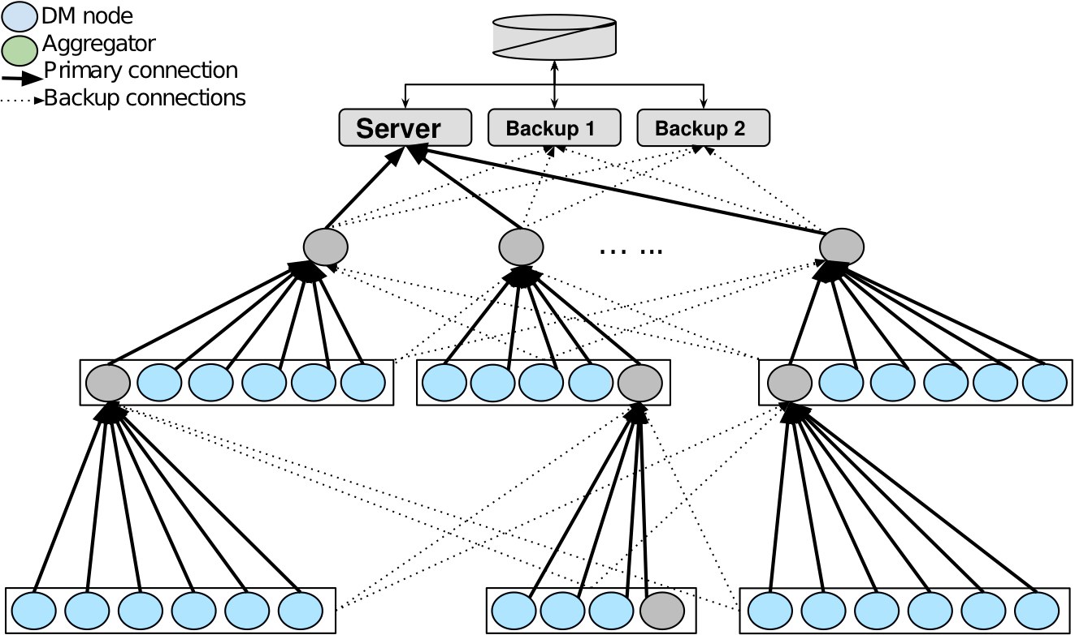
Flex-MPI
Focus on DaeMon
14th Scheduling for Large Scale Workshop
18
Notes:
Now I want to explain the DaeMon functionality.

Slide 19
Flex-MPI
DaeMon node
Node:
  DM starts as a watchdog process
  Each time interval it gets & sends the measures from the node
  DM sends an UDP packet with all data (compressed) through sockets to the server
    If server doesn't response in 3 tries, DM will change its server address to other in a backup list (TMR).
    It guarantees that we don’t lose any packet → unless a global failure in servers/aggregators/network.
14th Scheduling for Large Scale Workshop
19

Slide 20
Flex-MPI
DaeMon Optimization
In-node analysis:
  If DM obtains measurements within a tolerance the packet won’t be sent to the server
  In this case, DM will send one new packet each ten tries
14th Scheduling for Large Scale Workshop
20
Notes:
-10% of tolerance to avoid redundant information
- in order to tell server that the node is still alive
RESULTS IN NEXT SLIDE
We consider that it’s no necessary to send two packets which are so similar because the final user will see the same results in terms of performance, so we prefer to reduce the network traffic and the server load (less packets to process).
The servers have mechanisms to detect failed nodes, so this feaure is like a heartbeat.

Slide 21
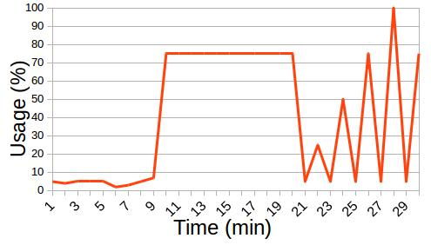
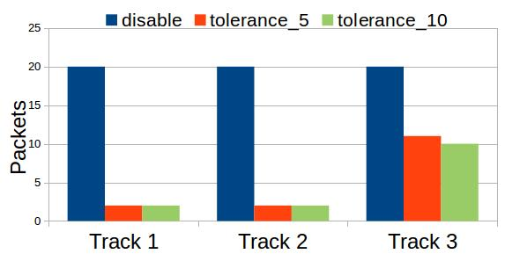
Flex-MPI
DaeMon Optimization
Track 1
Track 2
Track 3
14th Scheduling for Large Scale Workshop
21
Notes:
Description 1st image: Variable workload (10’ tracks)
1st track: idle
2nd track: 75% constant load
3rd track: +/- 25% load each 2 min.
Note: 30’’ measuring period
Description 2nd image: In-node analysis reduces traffic:
Up to 90% in 1st and 2nd track
Almos 50% in 3rd track
Reduction depends on the load variability but, in the worst case the traffic will be the same.

Slide 22
Flex-MPI
Global optimization
Topology-aware and auto-deployment (in process)
    The framework is able to discover the topology of the system
    Deployment in two phases:
      Deployment files configuring based on topology
        Topology discovering and auto-organization
        Static with auto-organization
        Static
      Run with that configuration
14th Scheduling for Large Scale Workshop
22
Notes:
With this feature we abstrat to the user about the phisical organization of its cluster. In this case, the framework will detect the topology and it will organize itsself to provide the óptimal performance reducing the amount of aggregators.
user defines machines and we organize aggregator nodes
user defines the complete deployment

Slide 23
List of contents
Introduction
System architecture
  Overview
  DaeMon Monitor
  Application Control
Evaluation
Conclusions & future works
14th Scheduling for Large Scale Workshop
23
Notes:
Finishing the monitor explanations, I have to explain the application control, which corresponds to this part

Slide 24
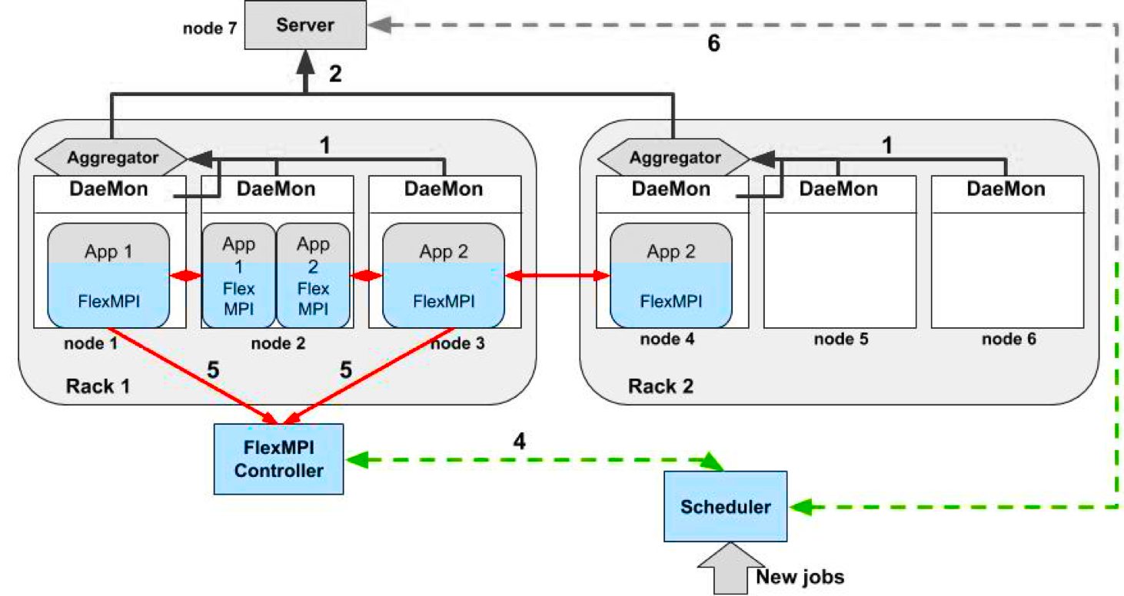
Flex-MPI
FlexMPI and scheduler
14th Scheduling for Large Scale Workshop
24
Notes:
Destacar FlexMPI y Scheduler
Plantearse 2 traspas

Slide 25
Flex-MPI
Application control
It includes:
  FlexMPI runtime
  System scheduler
This module receives information from the monitoring module
  Hotspots
  Optimal nodes for different kinds of applications
With this information in real-time, scheduler can take better decisions
14th Scheduling for Large Scale Workshop
25
Notes:
Provides dynamic load balancing and malleability
Performs the analysis and coordination of the running apps (and new suture apps)
Allocate apps in better nodes
Move applications with poor performance to better nodes

Slide 26
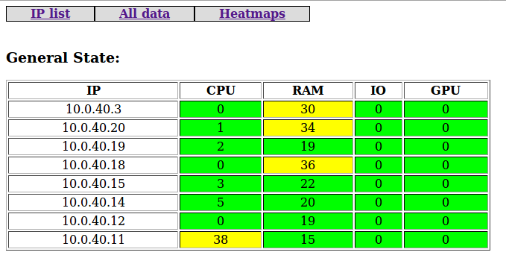
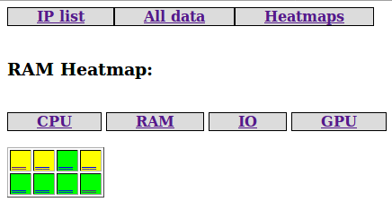
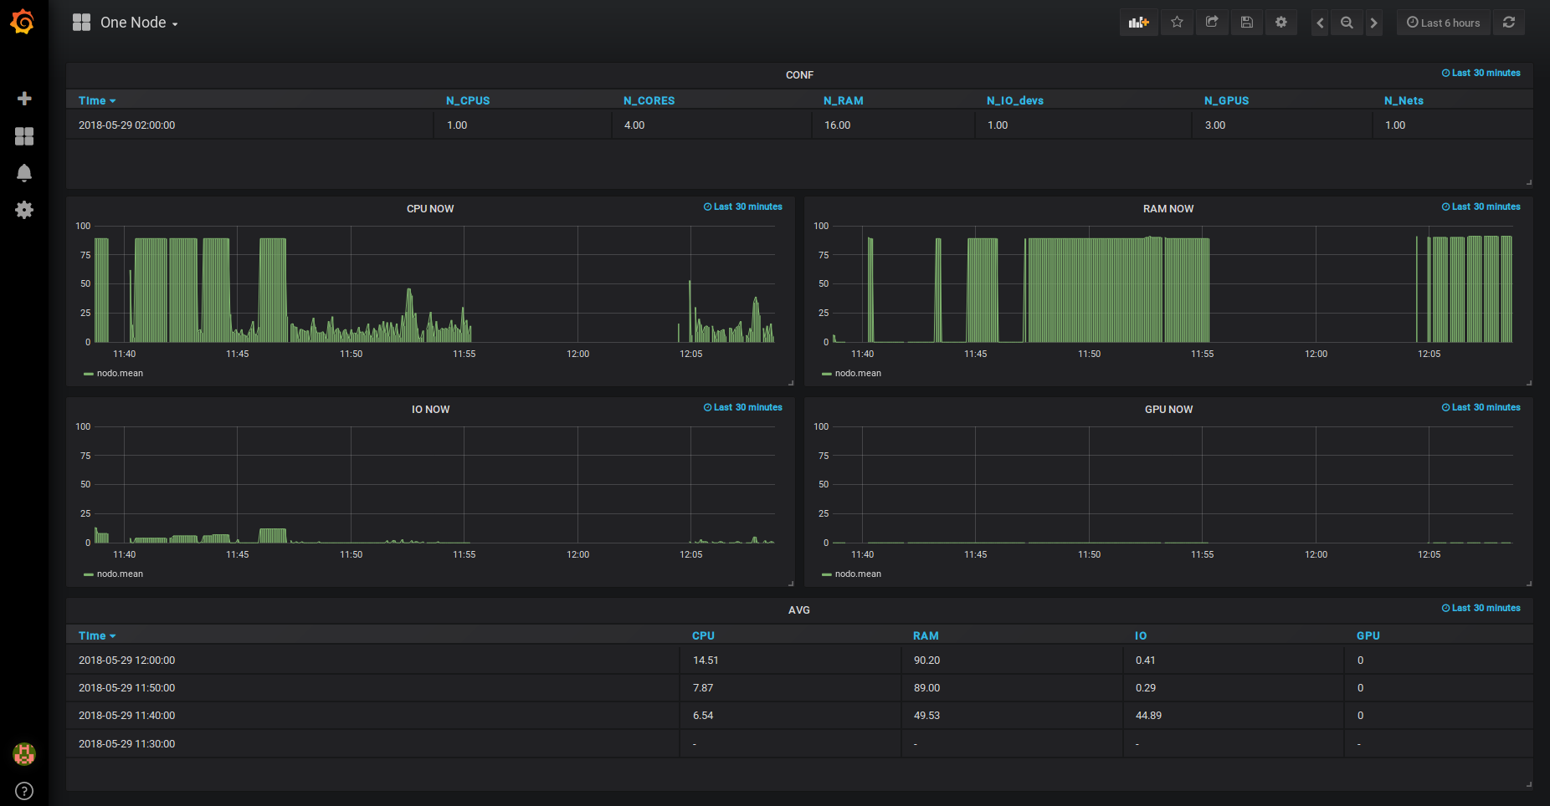
Flex-MPI
Visualization
fLASHINg
Grafana
14th Scheduling for Large Scale Workshop
26
Notes:
Here you can see two methods that we use to display the cluster state.
On the top you can see our tool, developed in JS, which provides heatmap views of the main metrics for each node. So, in a simple view you can see the whole system state.
Below it, you can see a Grafana dashboard which is connected to the server thanks to a library that we have developed for clients. Obviously, this dashboard must be created by the user. But you can use your own tools because with the client library you can get the information directly from the server.

Slide 27
List of contents
Introduction
System architecture
  Overview
  DaeMon Monitor
  Application Control
Evaluation
Conclusions & future works
14th Scheduling for Large Scale Workshop
27

Slide 28
Flex-MPI
Evaluation
Execution modes based on features
 | Mode I | Mode II | Mode III
Active capability components to support the load | N | N | N+2
Data Distribution paths | 1 | 1 | 3
Node level fault tolerance | No | Yes | Yes
Network level fault tolerance | No | No | Yes
14th Scheduling for Large Scale Workshop
28
Notes:
Tier I: N nodes to support the load; Only one connection between nodes; No watchdog process in nodes and no redundant
Destacar columna y animar

Slide 29
Flex-MPI
Evaluation
Execution modes based on features
 | Mode I | Mode II | Mode III
Active capability components to support the load | N | N | N+2
Data Distribution paths | 1 | 1 | 3
Node level fault tolerance | No | Yes | Yes
Network level fault tolerance | No | No | Yes
14th Scheduling for Large Scale Workshop
29
Notes:
Tier I: N nodes to support the load; Only one connection between nodes; No watchdog process in nodes and no redundant
Destacar columna y animar

Slide 30
Flex-MPI
Evaluation
Execution modes based on features
 | Mode I | Mode II | Mode III
Active capability components to support the load | N | N | N+2
Data Distribution paths | 1 | 1 | 3
Node level fault tolerance | No | Yes | Yes
Network level fault tolerance | No | No | Yes
14th Scheduling for Large Scale Workshop
30
Notes:
Tier I: N nodes to support the load; Only one connection between nodes; No watchdog process in nodes and no redundant
Destacar columna y animar

Slide 31
Flex-MPI
Evaluation
Scalability
  Evaluated with OMNET++ and real clusters
  Model:
    Nodes send 1500B packets (UDP)
    Send interval: 1s
    10Gbps ethernet connection between nodes
    Delay to process each packet added (worst case)
*Theoretically one server
could manage up to 200 nodes
14th Scheduling for Large Scale Workshop
31
Notes:
We have test our framework in a real cluster and in OMNET++. We have modeled our framework as an application which sends UDP packets through the network to the server, and the server spends some time to process each packet. This is the worst case, in which one server has only one thead to process the information.
With this model, theoretically one server could manage up to 200 nodes, but with a server with more than one thread, and with the “in-node analysis” enabled, this value increases.

Slide 32
Flex-MPI
Evaluation
Scheduling
The overall time saved: 5,558s
The total overhead: (4.8%)
44.8s for process creation/destruction
223.2s for data redistribution
14th Scheduling for Large Scale Workshop
32
Notes:
This graph displays the execution time that some application have spent with and without our framework (Applications like epigraph or jacobi).
X axis is the name of the applications and Y-axis represents the execution time.
In a summary, if we detect interferences between two applications we will move one of each because the migration overhead is lower than the time that the application would spent running in the shared node.
-> by avoiding the contention
-> for all the applications. Time spent in process creation/destruction and 223.2 for data redistribution.

Slide 33
List of contents
Introduction
System architecture
  Overview
  DaeMon Monitor
  Application Control
Evaluation
Conclusions & future works
14th Scheduling for Large Scale Workshop
33
Notes:
And finally, the conclusions and future works.

Slide 34
Conclusions
Monitoring tool with many desirable capabilities
DaeMon and App. Controller work in a coordinated way to:
  improve the overall platform performance
  reduce the amount resources by the system
Dynamic scheduling based on monitoring
14th Scheduling for Large Scale Workshop
34
Notes:
We have developed a …. (light-weight, real-time, fault tolerance and resilience)
→ And is able to reduce the energy consumption thanks to sharing nodes.
With Interference detection and malleability in order to avoid the contention.
I think that we reach all of our goals…

Slide 35
What’s next?
  Topology-aware and auto-deployment
  Partial data analysis and compression
  Scheduling policies based on energy
  Create a Slurm plug-in
14th Scheduling for Large Scale Workshop
35
Notes:
to obtain the best performance without any system organization knowledge
Allowing the user not to wait the information into the main server
Leveraging the framework to reduce the consumed energy. We have this values but we haven’t any policy yet.
to reduce network traffic and reduce master server load
Group different samples in aggregator nodes → to reduce network traffic
Slurm plug-in to override its default scheduler.

Slide 36
Adaptive scheduling of HPC applications using malleability and dynamic migration.
Thank you
Alberto Cascajo, David E. Singh and Jesús Carretero
University Carlos III of Madrid (Spain)
14th Scheduling for Large Scale Workshop

Slide 37
Data displayed
Information collected by DaeMon on each node:
  IP address: Host IP
  Mem: Total dynamic memory (in GB)
  Mem. Usage: Percentage of memory used
  NCPUs: number of CPUs in the current node
  CPUBusy: percentaje of CPU busy in the sampling interval
  Energy: Jules consumed in the sampling interval
  w: percentaje of writes related to IO traffic in the sampling interval
  tIO: percentaje of IO time in the sampling interval
  Speed: Speed of the network interface (Gbps)
  NetUsage: percentaje of network interface used in the sampling interval
  CurrentTemp: Current temperature of each cpu on ºC
  Temp%: Percentage of temperature reached based on the max. temperature.
  vCoreUsage: Percentage of cpu busy in the sampling interval of each virtual core
  For Nvidia GPUs whit CUDA installed:
    GPU mem. usage
    Computation usage
    Temperature
    Energy consumed in sampling interval.
  Possibility to show percentage of hits/misses in cache
14th Scheduling for Large Scale Workshop
37

Slide 38

Conclusions
Feature comparison
 | In-node análisis | Autorun & Self-control | In-memory DB | Topology-aware | Multi-criteria resource allocation | Hotspot notification | Data visualization
DaeMon
MonALISA
Collectl
Collectd
14th Scheduling for Large Scale Workshop
38
Notes:
Monalisa gather information into switch
Preguntar a Jesús.
es

Slide 39
Conclusions
Feature comparison II
 | Scalability | App. Level fault tolerance | Node level fault tolerance | Global state visualization
DaeMon
MonALISA
Collectl
Collectd
14th Scheduling for Large Scale Workshop
39
Notes:
Global state visualization: Heatmaps vs Charts

Slide 40
Flex-MPI
Visualization
Admin/Client Libraries
  Gets information directly from the server
  Admin library includes methods to manage the DB.
  Client library includes methods to get and process the information.
fLASHINg (LArge Scale Heatmap vIsualizer with Nodejs)
  In combination with C-API and InfluxDB, it displays the whole system state in a dynamic webpage
Grafana
  In combination with C-API and InfluxDB, you can see graphically the current system state
14th Scheduling for Large Scale Workshop
40
Notes:
Comentar directamente con las figuras

Slide 41
Flex-MPI
DaeMon Monitor
Figure 2 - Large scale deployment example.
14th Scheduling for Large Scale Workshop
41
Notes:
Ocular y destacar los azules

Slide 42
Flex-MPI
Related work
Similar to DaeMon Monitor
  MonALISA
  Collecl
  Collecd
Similar to our framework
  LoTES
We wanted to develop our own system monitor (improving all features that we consider interesting) and scheduler
  To create novel policies to obtain the best performance in combination with save the big amount of energy as possible (sharing nodes between apps)
14th Scheduling for Large Scale Workshop
42
Notes:
MonALISA:
-scalability based on use if a multi-threaded engine to host a variety of services: client, visualization, … (like us).
-Provides real-time info and historical data (like us).
-Pool of threads (to do, but we have a queue for messages in order not to lose any packet).
Collectl:
-Program like DaeMon but only gets measures from system and plot them.
-We add communication with client, event notification, filtering, history, visualizer…
-We allocate resources and choose the best nodes to run apps.
Collectd:
-Daemon which collects system and application performance metrics (like us)
-Provides mechanisms to store the values (like us)
-Monitoring feature is limited to threshold checking.
LoTES:
-Similar to Tetris but their objective is the minimization of the system’s average job response time.
-Not online analysis and scheduling. It’s based on preprocessing, so the scheduling is static.

Slide 43
Flex-MPI
FlexMPI and scheduler
14th Scheduling for Large Scale Workshop
43
Notes:
Destacar FlexMPI y Scheduler
Plantearse 2 traspas

